Slide 1
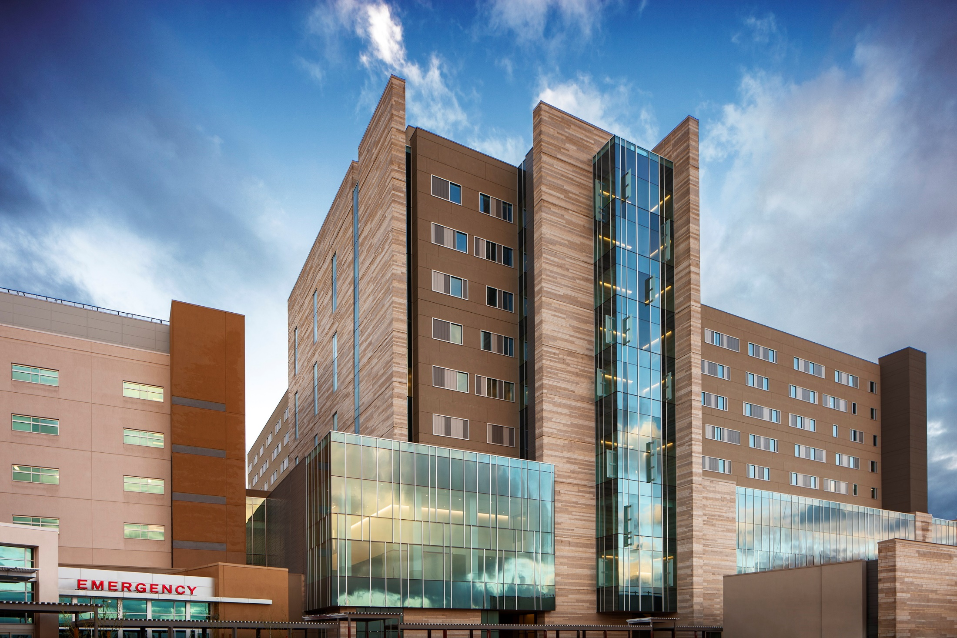
Department of Obstetrics and Gynecology
University of Arizona Health Sciences

Slide 2
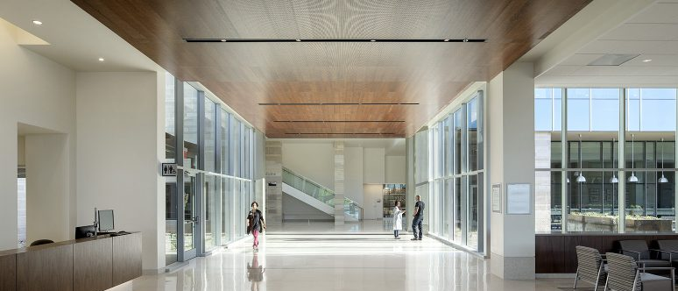
Banner University Medical Center Tucson

Slide 3
University of Arizona Core Values
Integrity: be honest, respectful and just
Compassion: choose to care
Exploration: be insatiably curious
Adaptation: stay open-minded and eager for what’s next
Inclusion: we’re better together
Determination: bear down!

Slide 4
University of Arizona
UA ranks in top 20 research (NSF)
UA top 4% of all US Universities in research (NSF)
Ranked #23 biological and biomedical sciences
Ranked #48 Health Science
MFM FELLOWSHIP | THE UNIVERSITY OF ARIZONA
It matters because we are surrounded by a major think tank and the possibilities for collaboration are endless!

Slide 5
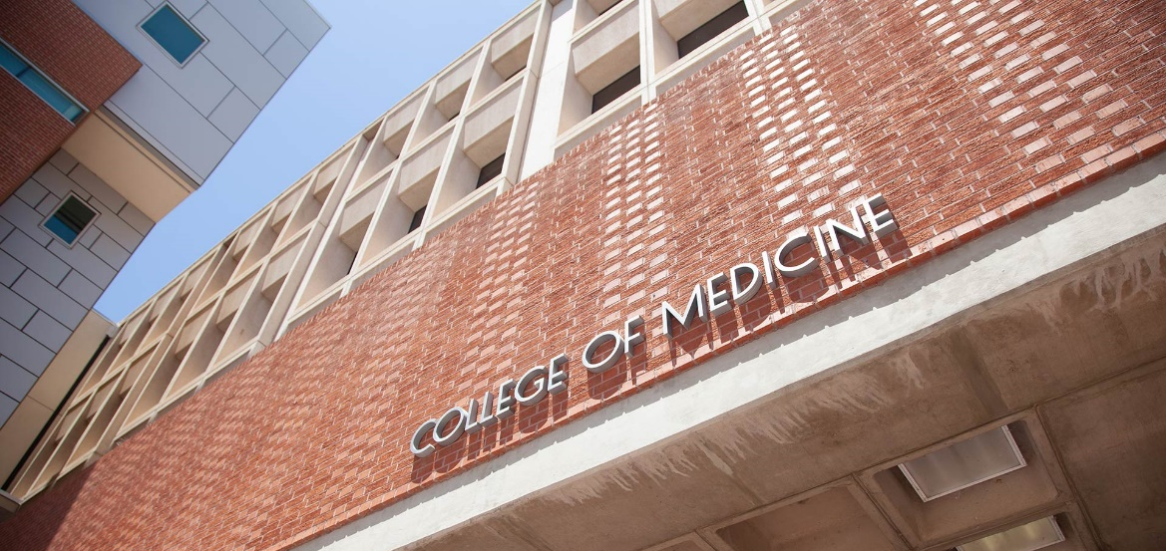
Department of Obstetrics and Gynecology
Maternal-Fetal Medicine

Slide 6
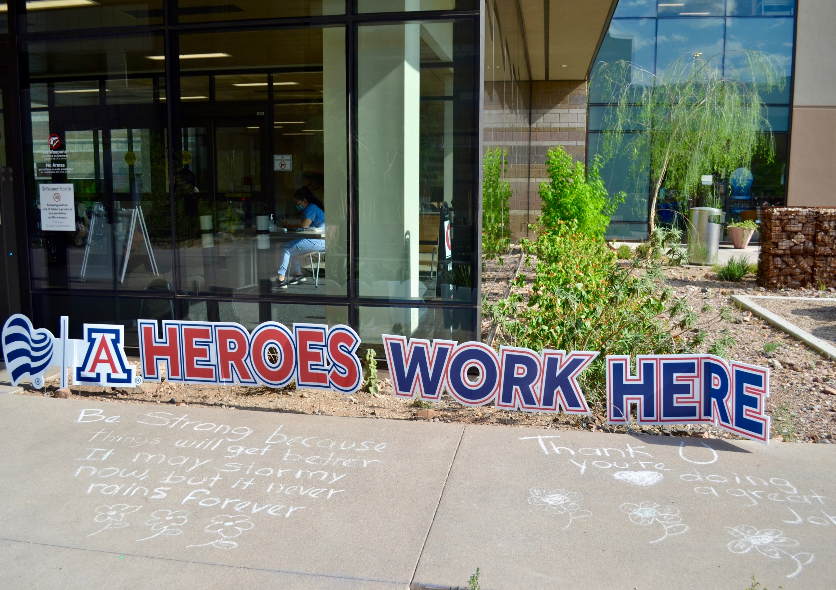

Slide 7
Banner Health Care Systems and Banner University Medical Center
2015: Banner University Medical Center officially took over operations of the University Medical Center Hospital
2019: Opened Tower 1, a brand-new state of the art hospital with a new labor and delivery unit
One of the largest, non-profit health systems in the US
28 Acute care hospitals
6 sites: AZ, CA, CO, NE, NV, WY

Slide 8
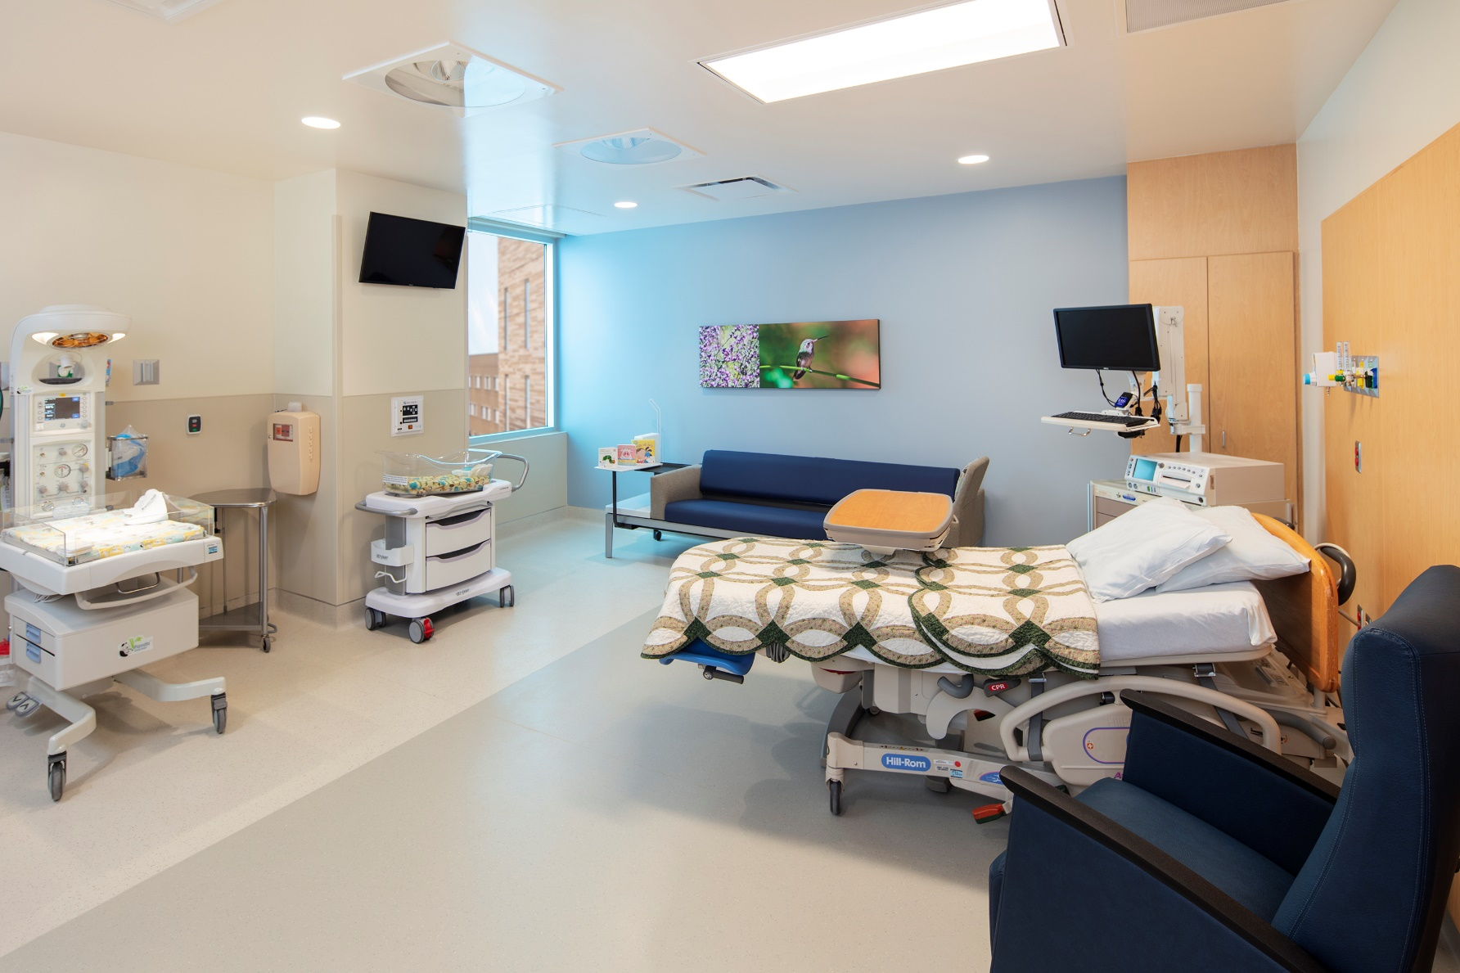
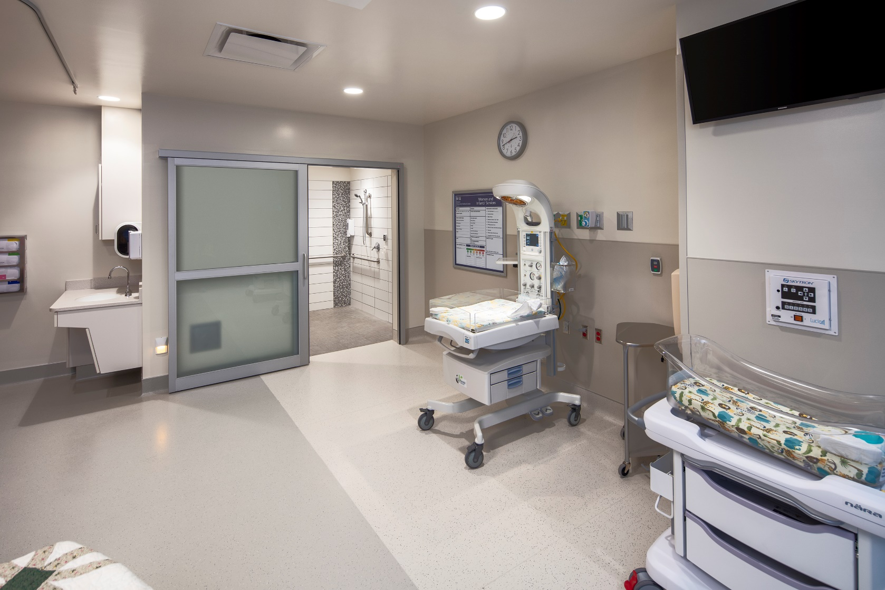
Banner University Medical Center Labor & Delivery
V
MFM FELLOWSHIP| THE UNIVERSITY OF ARIZONA

Slide 9
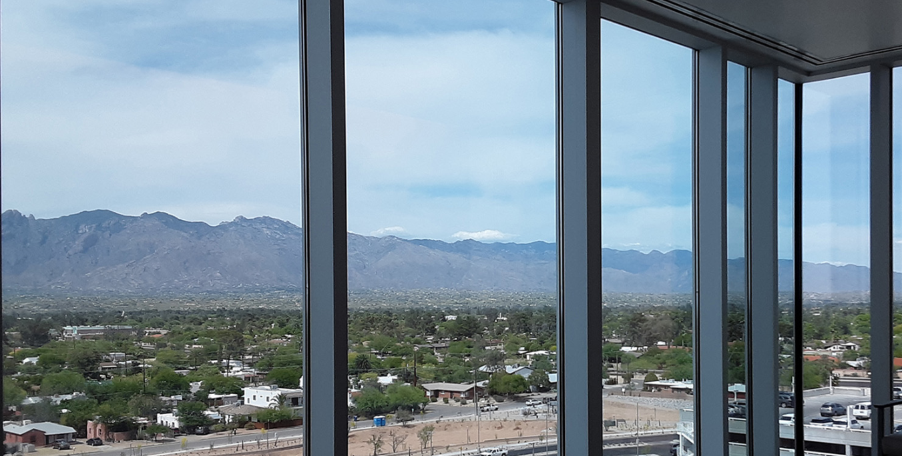
V
MFM FELLOWSHIP| THE UNIVERSITY OF ARIZONA

Slide 10
Faculty
Academics
Our faculty have experience in pure “academics” to private practice and back
Global perspective
Diverse patient population
Unlimited research potential
ACGME with the full accreditation
The ability to write your own story!
Why choose our fellowship?

Slide 11
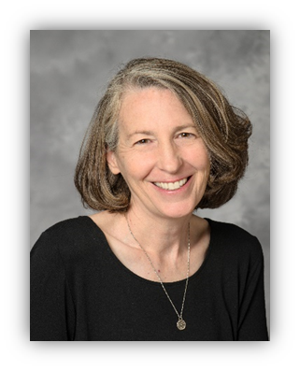
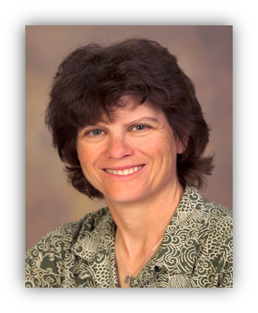
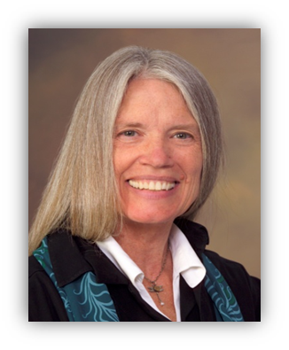
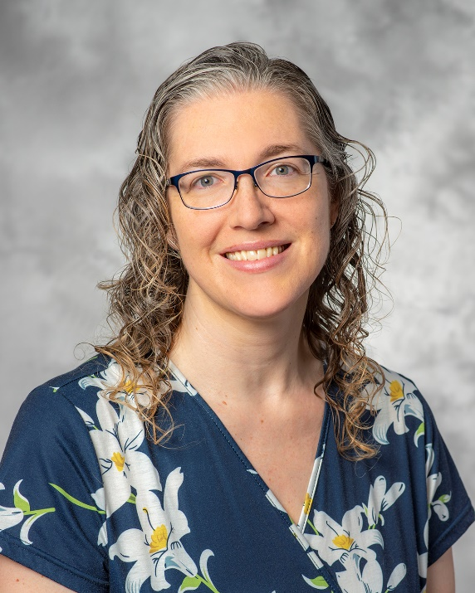
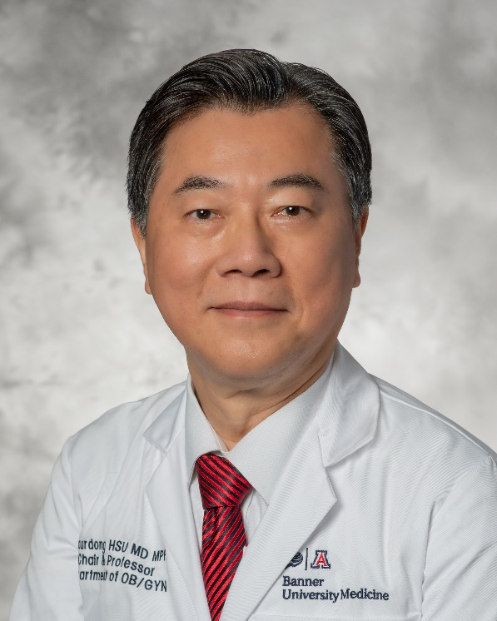
MFM Fellowship Faculty
Lynn Coppola, MD, MPH
Interim Program Director
Karen Lesser, MD
Division Director MFM
Teresa Orth, MD, PhD Clinical Assistant Professor
Chaur-Dong Hsu, MD, MPH
Department Head
Kathryn Reed, MD
Professor Emeritus
Kathryn Reed, MD
Professor Emeritus

Slide 12
Who are we?

Slide 13
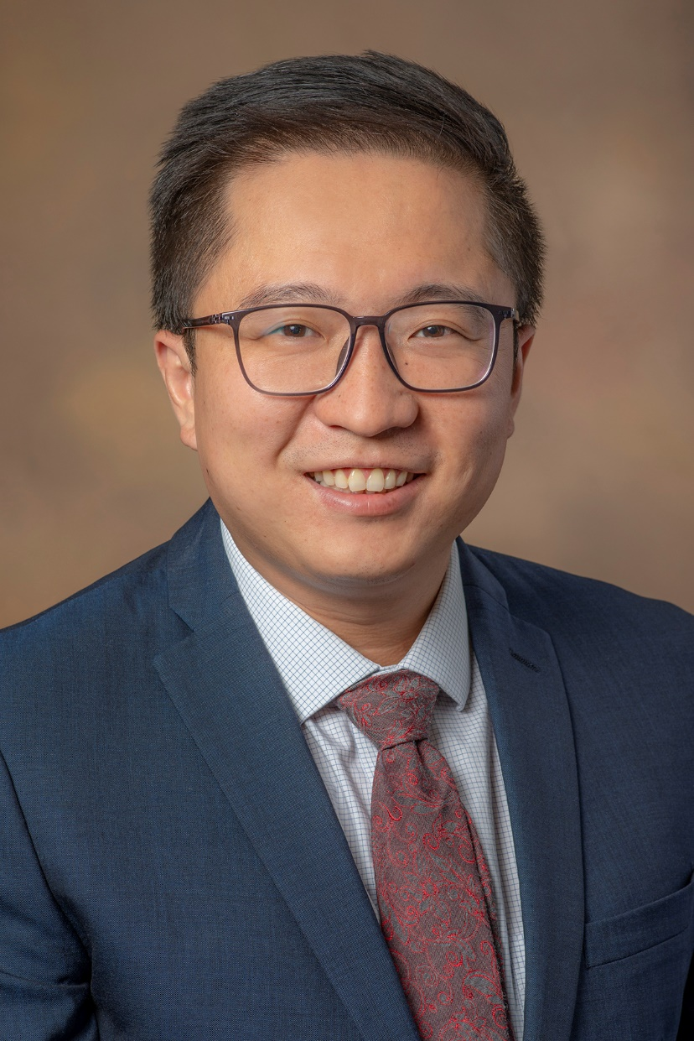
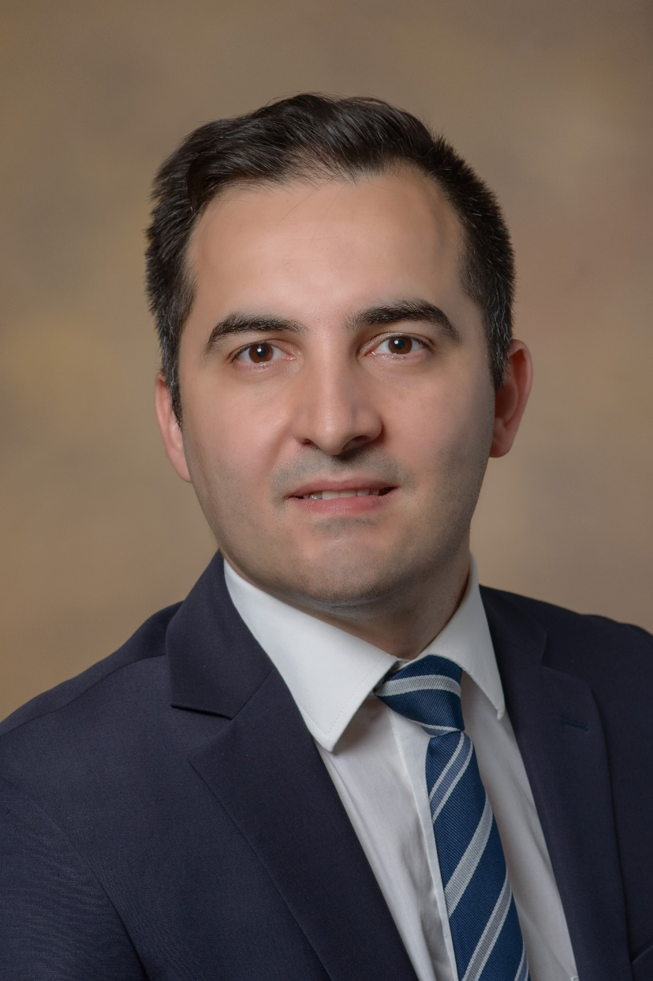
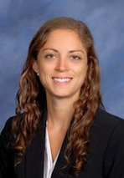
Our Maternal-Fetal Medicine Fellows
DAWIE DAVID WANG, MD
2020-2023
GIOVANNI SISTI, MD
2021-2024
LAURA MROUE, MD
2022-2025

Slide 14
Our newest MFM Fellow: Laura Mroue, MD
Residency: Detroit Medical Center/Wayne State University
Medical School: Wayne State University School of Medicine
Hobbies: Rock climbing, running, biking, hammocking, gardening, cooking, and reading
We can’t wait to welcome her to the team!!

Slide 15
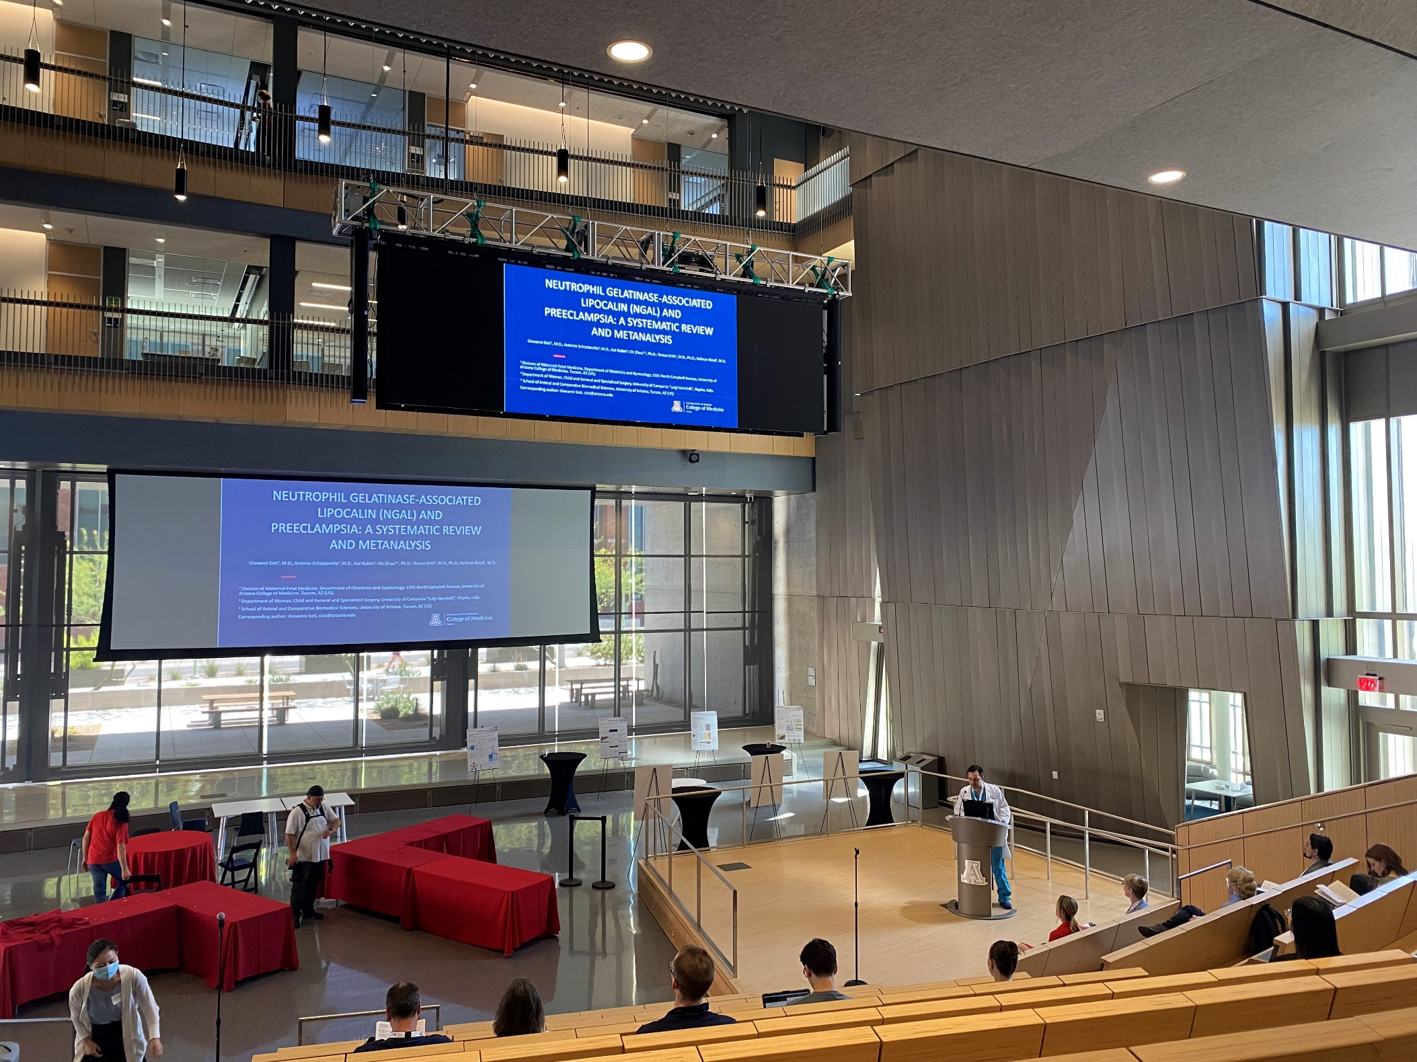
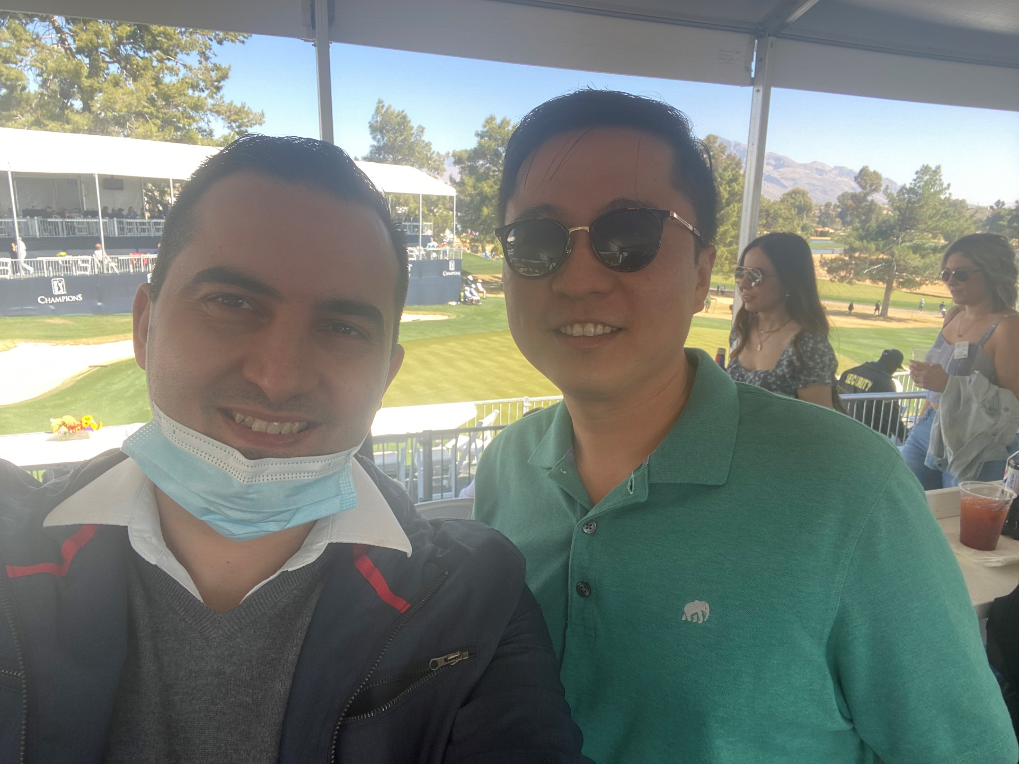
Our Fellows at work and play!

Slide 16
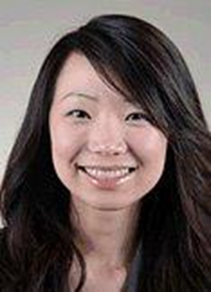
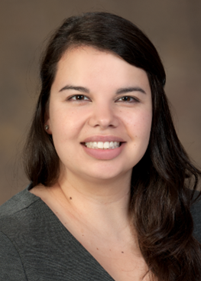
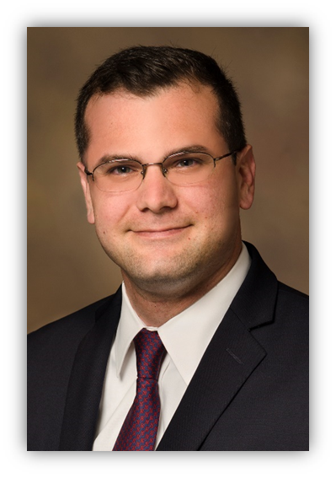
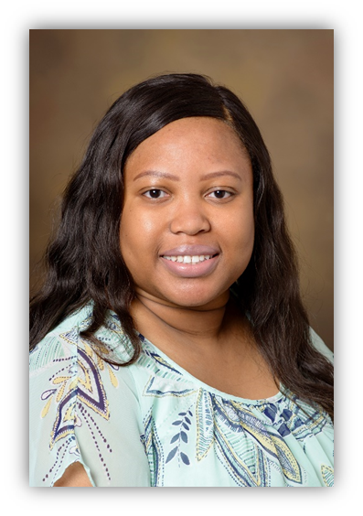
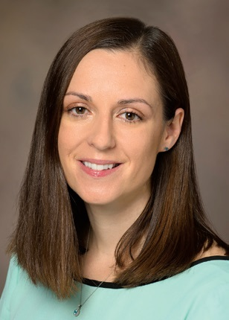
Previous MFM Graduates
Ruth Wei, MD
Seattle MFM
Maritza Gonzalez, MD
University of Chicago
Kareem Tabsh, MD
California MFM
Adeola Awomolo, MD
Houston, TX
Heather Miller, MD
Salt Lake City, UT

Slide 17
The Department of OB/GYN

Slide 18
Department of OBGYN Chair
Chaur-Dong Hsu, MD, MPH, FACOG
Professor & Department Head, Obstetrics & Gynecology
Project Site Consultant, Perinatology Research Branch, NIH
Well funded researcher with nearly 300 publications
Research Interest: Obstetrical syndromes, personalized obstetrics, preeclampsia, intraamniotic infection
Clinical Interest: Complex MFM cases and perinatal ultrasound

Slide 19
Interim Program Director:
MFM Fellowship
Lynn Coppola, MD, MPH
Assistant Professor, Obstetrics & Gynecology
Interim Director, Maternal-Fetal Medicine Fellowship
Research Interest: International health, disparities, and access to care
Clinical Interest: Obstetrical and surgical complications of pregnancy, maternal cardiac disease, and ultrasound

Slide 20
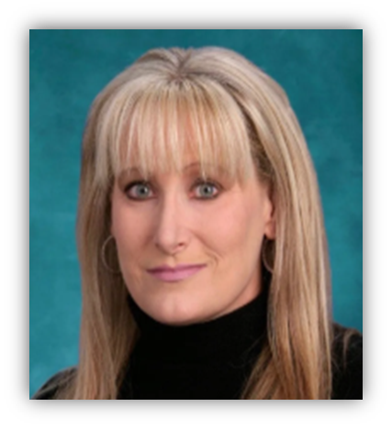
MFM Fellowship Core Faculty
Julia Solomon, MD, FACOG
Director of the Fetal Diagnostic Center of Arizona
Private “boutique” practice
Board of Governors for the AIUM and is current chair for the OB community of AIUM
Associate Clinical Professor, University of Arizona
Committed to working with our MFM Fellows to expand their expertise in Prenatal Ultrasound and Fetal Echocardiography

Slide 21
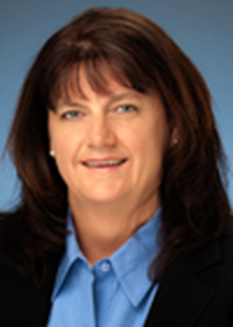
MFM Fellowship Core Faculty
Mary (Gina) Connelly, MD, FACOG
UA graduate from Residency and MFM Fellowship
Tucson Medical Center
Community based large MFM practice
Works extensively with our residents and fellows
Expertise in Obstetrical Simulation

Slide 22
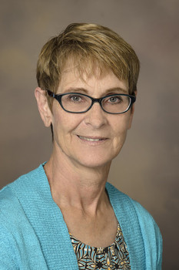
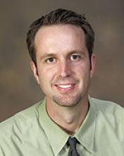
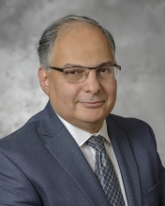
MFM Fellowship Faculty
DEE L. QUINN, MS, CGC
Director, Genetic Counseling Services / Clinical Genetics
Director, Genetic Counseling Services
BRENT BARBER, MD
Pediatric Cardiology
Fetal Echocardiography
Neuromuscular Cardiac Disorders
MOHAMED AHMED, MD, PhD
Division Chief
Associate Professor
Arizona Elks Endowed Chair in Neonatology

Slide 23
Other Core Faculty
Truc-Anh T Nguyen, MD
Clinical Assistant Professor, OB Anesthesia
Elizabeth Juneman, MD
Associate Professor, Medicine & Cardiology – Lead for the Cardiac OB Clinic
Melissa Furlong, MD
Assistant Professor, School of Public Health
Sean Limestand, PhD
Professor, Animal & Comparative Biomedical Sciences
Michael Harris, MD
Professor, Immunology, Director, Arizona Health Sciences Center Biorepository
Urs Utzinger, PhD
Associate Professor, Biomedical Engineering
And many more!!

Slide 24
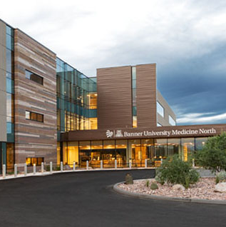
BUMC North Campus
Maternal-Fetal Medicine
10 exam rooms
2 MFM consult rooms
6 ultrasound suites
3 procedure rooms

Slide 25
Our BUMC MFM Team!
MFM Attendings and Fellows
Perinatal Nurse Coordinator: Krista Williams, RN
Fetal Diagnostic Center: Nydia Borjon, RDMS
Social Work: Joy Subrin, CSW
Diabetes Educator: Kelly Yee, CDE and RD
And many more!!
Our overarching goal is to make every patient encounter unique and to provide seamless transitions of care between inpatient and outpatient services and our referring providers.

Slide 26
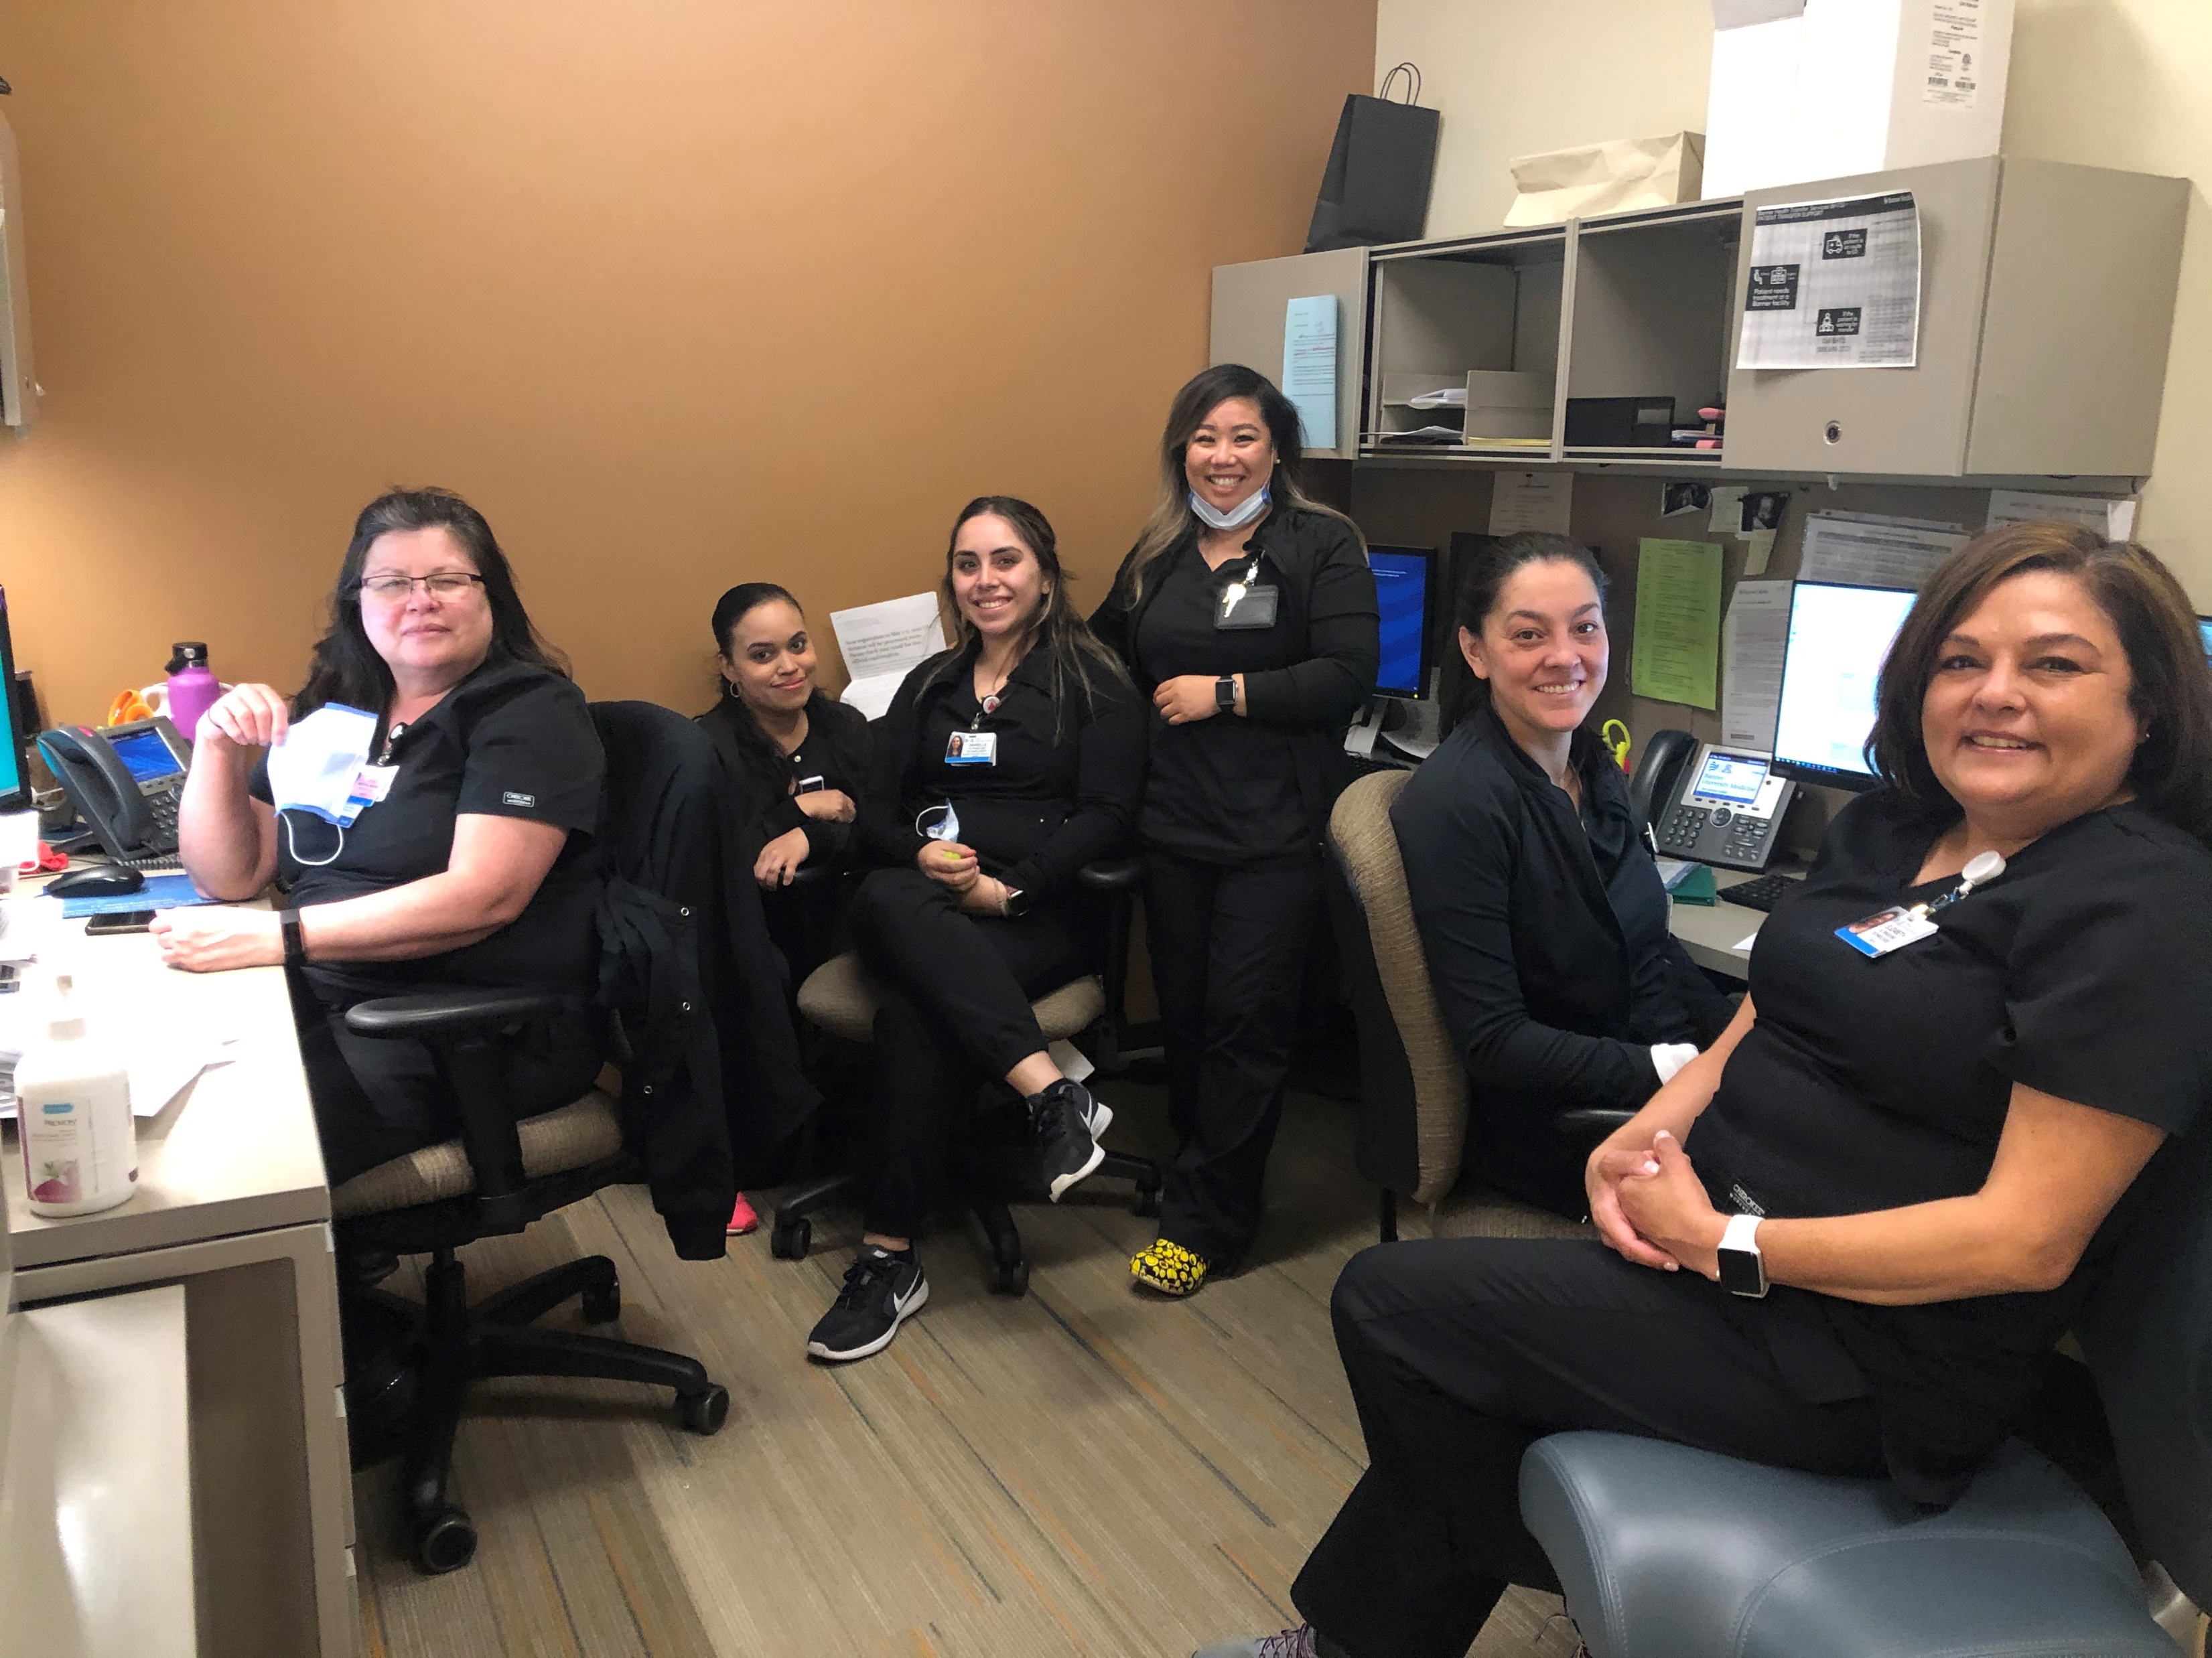
Our BUMC MFM Team

Slide 27
Our Specialty Clinics
MOMS Clinic
Diabetes Clinic
HROB Clinic
OB Cardio Clinic
Perinatal Ultrasound
Fetal Echo
Perinatal consultations
Genetics

Slide 28
How do we plan on meeting the ACGME and ABOG requirements and still have a well-rounded program?
Requirements: Are better defined but harder to achieve with balance
Our goal for each year: 6 months clinical, 4 months research, and 2 months if electives
Total: 18 months clinical, 12 research, and 6 electives
We are willing to adjust as needed to accommodate research plans and desire to do away electives or travel abroad

Slide 29
Research
Block assignment will be based on fellow’s interests, goals, and previous accomplishments
Monthly blocks vs longer dedicated time
Large academic community who wants to work with us
You can carve out your own path! We will make it work as long as it improves women’s health, advances our specialty, and is easily and clearly definable
Additional months of elective can be dedicated to research with Program Director approval

Slide 30
Research: Recent Accomplishments
Developing relationships with new collaborators across UA and the country
College of Public Health, Bio5 Institute, Genomics Institute, etc.
Shoring up the infrastructure for research
Departmental Research Coordinator
Restoring expectations that research takes a village and enhances the program as a whole

Slide 31
Research: Current Projects
RCT Green Light Therapy for Women with OUD
RCT Oral glucose Load Prior to Cesarean and Neonatal Hypoglycemia
Pre-Preeclampsia: A New OB Pathology
DASH NIH Database Secondary Analysis
Stage One Hypertension and OB Outcomes Meta-Analysis

Slide 32
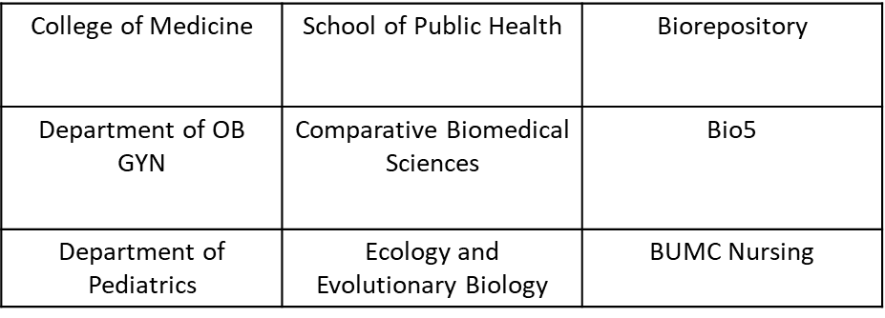
Prospective Cohort Study of COVID-19 Outcomes Among Mother-Infant Dyads
MFM FELLOWSHIP | THE UNIVERSITY OF ARIZONA

Slide 33
Clinical Rotations (6 months per year)
PGY 5:
1 supervisory role on L+D at TMC
1 dedicated US month
4 months clinical fellow (outpatient consults/clinics/1 L+D/genetics/fetal echo/ultrasound)
PGY 6:
1 month dedicated US
1 month ICU
4 months clinical fellow (outpatient consults/clinics/1 L+D/genetics/fetal echo/ultrasound)
PGY 7:
1 supervisory role on L+D at BUMC
1 dedicated US month
4 months clinical fellow(outpatient consults/clinics/1 L+D/genetics/fetal echo/ultrasound)

Slide 34
Supervisory Role on Labor and Delivery
2 months supervisory role on labor and delivery
1 month first year at Tucson Medical Center
1 month third year at BUMC
Every Wednesday during clinical block (4 months/year)
Expectation is that the clinical fellow manage all critical care patients or highly medically complex during clinical rotations 24 hours a day

Slide 35
Prenatal Ultrasound
Dr. Solomon rotation: 1 month every year near Phoenix
Why? Because no one will pull you to do anything else!
Best technology on the planet
Dedication to teaching on how to perform, read, and communicate US findings
Each year you will be expected to grow your skills and acquire cases for independent certification including:
CLEAR
NT and first trimester detailed anatomy US
Anatomy survey in singleton and high order multiples
Doppler interrogation
Fetal Echo (BUMC every day, Dr. Barber and Dr. Soloman)

Slide 36
Genetics
Multipronged approach:
Genetics courses through University of Arizona PGY 5 and 6
Introduction to genetics: 1 credit course
Embryology and teratology: 3 credit course
Genetics courses through SMFM PGY 7
Boot camp
Basic training course in Reproductive Genetics 8-week curriculum
Genetics consultations
Genetic counselors at BUMC and Dr. Solomon rotation
Pediatric genetics clinics with Dr. Eugene Hoyme

Slide 37
Additional Courses
SMFM annual conference and courses
Critical care course SMFM
Genetic boot camp
Fetal Echo in Phoenix
MAT training
Genetics: Intro and embryology/teratology
Statistics
Others
Depending on available funding and schedule

Slide 38
Our commitment to your education
We as a Faculty and University welcome the opportunity to work with our new MFM fellow.
We pledge to do our best to help you accomplish all of your goals in your 3 years with us and beyond.
We have made great strides to adapt our curriculum to meet the ABOG and ACGME fellowship guidelines.
We have a very extensive academic community who embraces the opportunity for our fellows and faculty to help achieve their goals.
We are looking for an MFM fellow who desires to enhance the specialty and women’s care who will be a key member of our team.

Slide 39
We couldn’t exist without our incredible support staff!
Ashley Scott, U of A Program Coordinator, Fellowship Program
Sonia Garcia, U of A Senior Program Manager, Residency Program
Julie Tary, Clerkship Program Manager
Cindy Thompson, U of A Executive Assistant
Nicole Roldan, U of A Administrative Assistant
Sara Grigsby, Banner Administrative Assistant
Ana-Teresa Lopez, Banner Administrative Assistant
Andrea Kovatch, Banner Department Administrator
Christina Torres, Banner Physician Practice Operations Senior Manager

Slide 40
Thank you
lcoppola@obgyn.arizona.edu
ashleyscott@obgyn.arizona.edu

